Slide 1
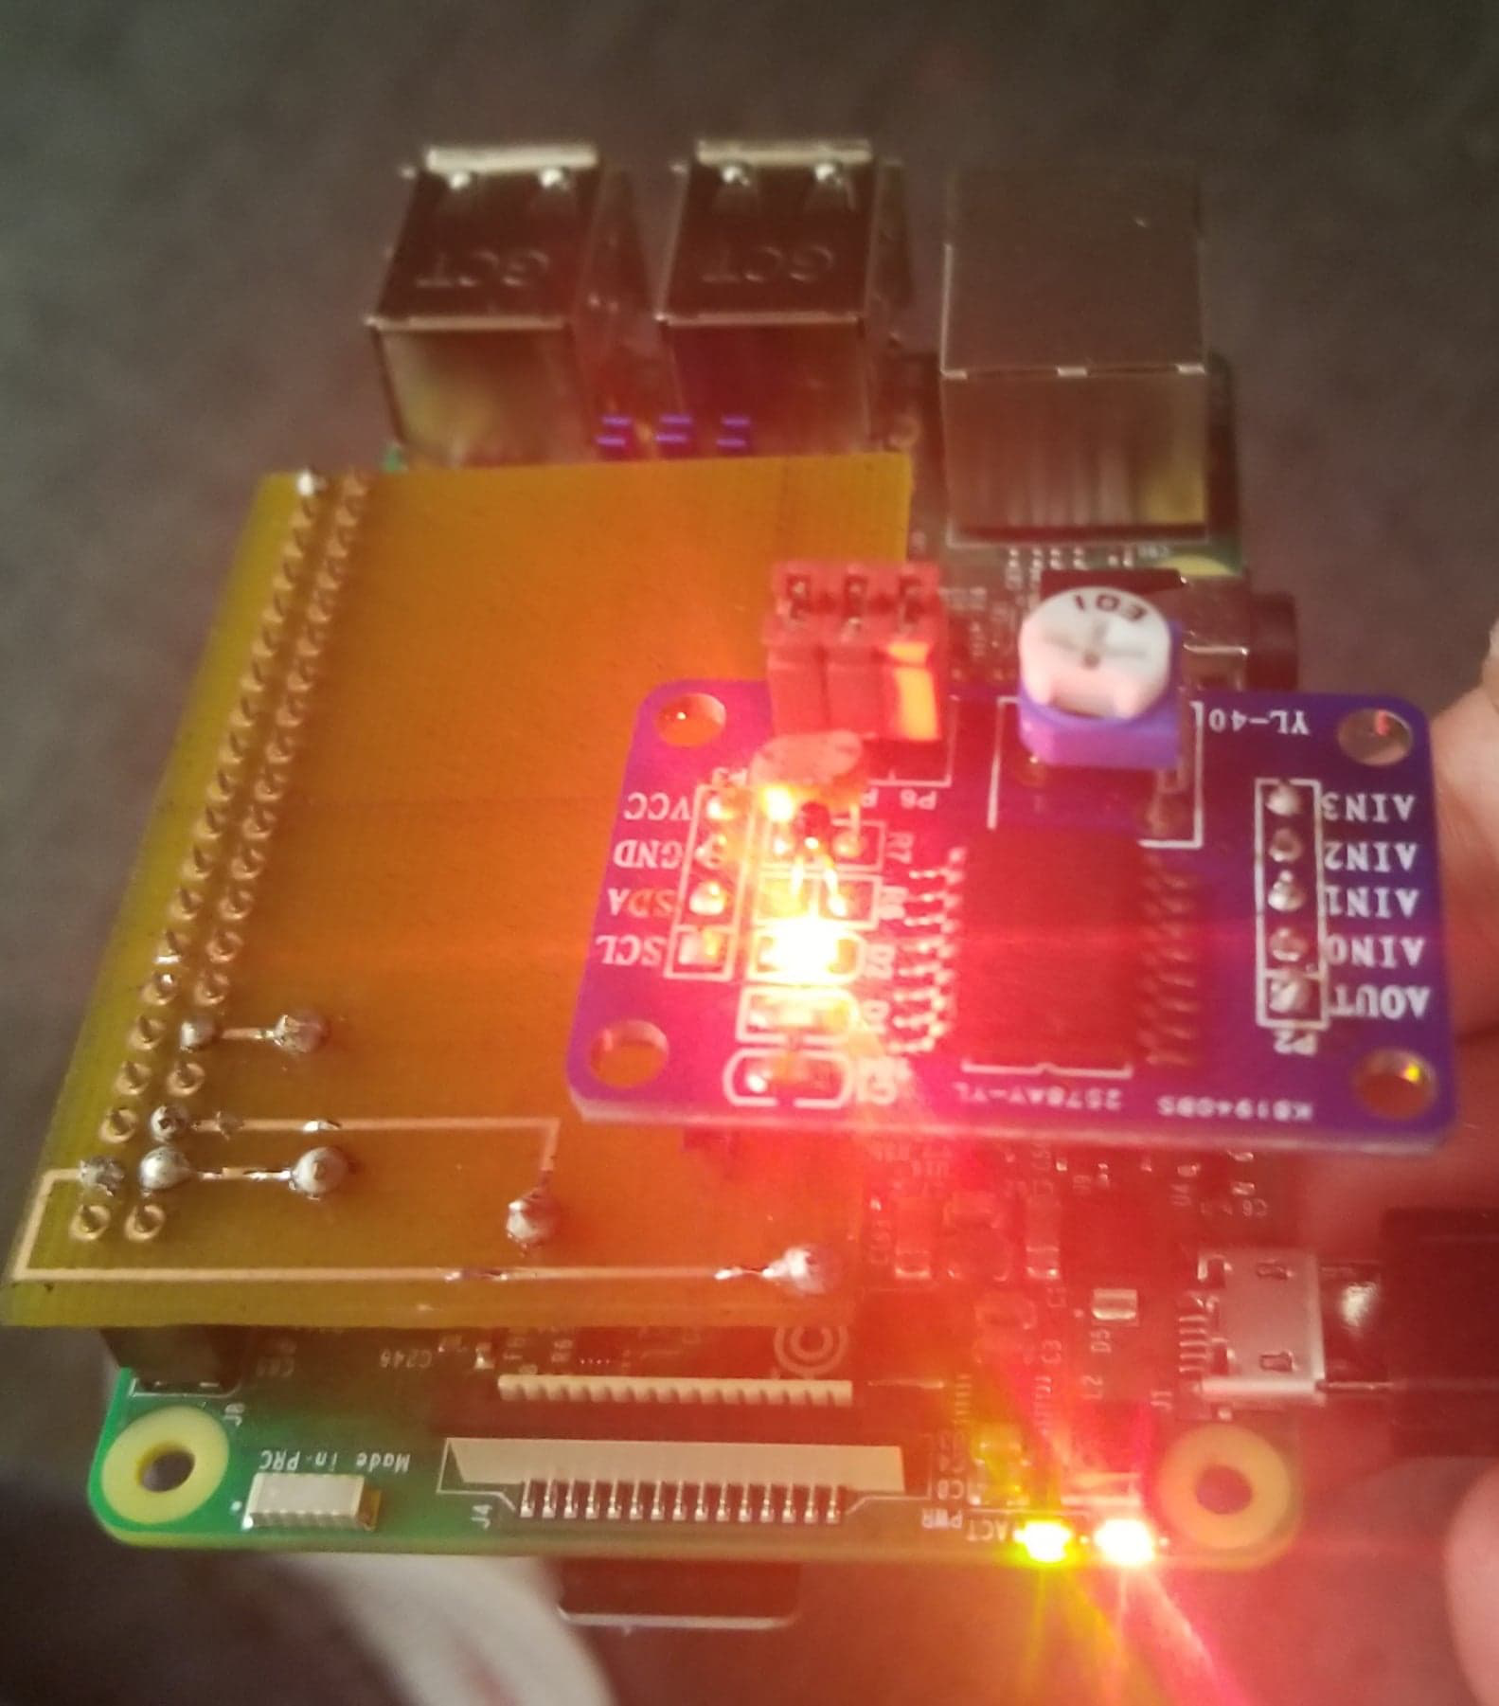
PCF 8591
By: Kogul Balasubramaniam
N01093997
CENG 317 – Hardware Production Tech

Slide 2
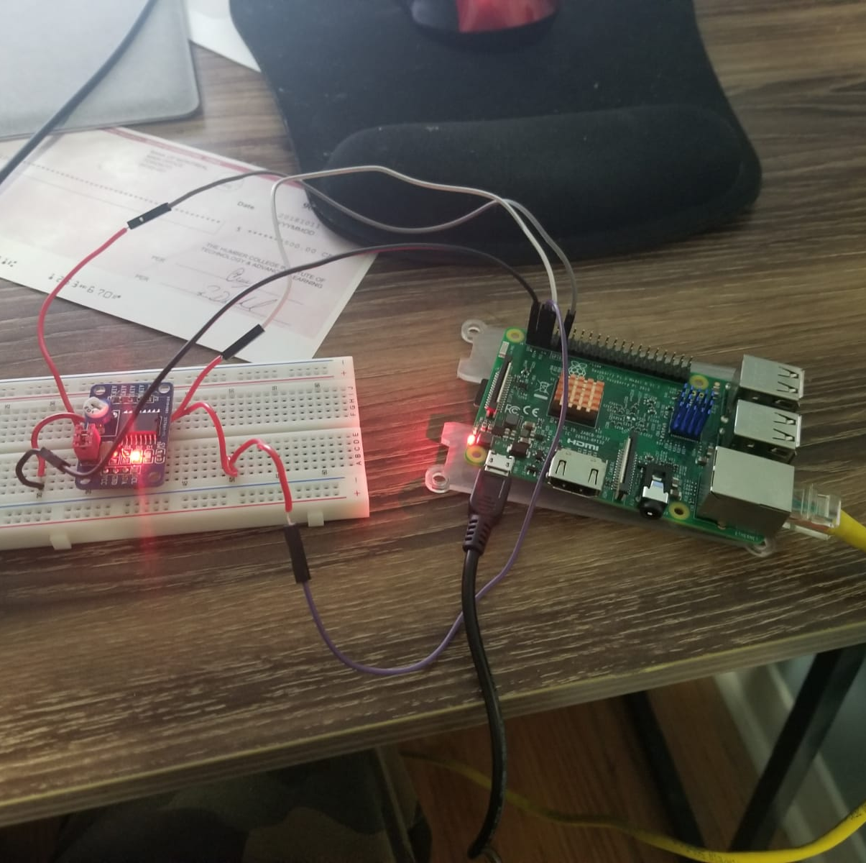
Proposal
The PCF 8591 is a module used as a DAC/ADC Converters. These being all usable through the I2C Bus.
The Pi itself can be used with just 3.3-5V, so for example a Raspberry Pi 3 development platform can be used.
The module contains a temperature sensor and a light sensor which can be used to get data on the current temperature and luminosity
The testing will show the use of the light sensor

Slide 3

Budget Plan
Parts | Source | Part Number | Unit Cost
Rpi 3 Kit | MakerSpot/Amazon | KRB0127 | $69.97
PCF 8591 | Sunfounder |  | $14.99
RJ45 Cat7 Ethernet Cable | Amazon | Hl-007826 | $8.99
USB 3.0 Gigabit Adapter | Amazon | AE3101X1 | $16.48
Breadboard/Parts Kit | Humber College |  | $100.00
Safety Glasses | Humber College |  | $5.00
Acrylic Case | Humber College |  | $7.00
Total |  |  | $222.43
Estimated Tax |  |  | $28.92
Grand Total |  |  | $251.35

Slide 4
Schedule
Task Name | Duration | Start | Finish
Testing Rpi Light Sensor | 1 hr | Tue 9/4/18 | Tue 9/4/18
Pick a Sensor | 30 mins | Tue 9/4/18 | Tue 9/4/18
Type up Proposal for Project/Gather Info about Project | 6 days | Tue 9/4/18 | Tue 9/11/18
Research on PCF8591 Sensor | 20 days | Tue 9/11/18 | Mon 10/8/18
Purchase Project Items | 7 days | Wed 9/19/18 | Thu 9/27/18
start working on Pseduo code assignment Wokring with first years | 6 days | Tue 10/9/18 | Tue 10/16/18
Implement Proejct on Breadboard Milestone of Project | 5 days | Wed 10/17/18 | Tue 10/23/18
Designing the PCB | 6 days | Tue 10/23/18 | Tue 10/30/18
Learining to Solder/Soldering PCB | 5 days | Wed 10/31/18 | Tue 11/6/18
Enclosure | 9 days | Thu 11/8/18 | Tue 11/20/18
Final Presenations | 6 days | Tue 11/27/18 | Tue 12/4/18
Final Outline of Build Instruction | 10 days | Tue 11/27/18 | Mon 12/10/18
My Schedule has slightly changed and altered throughout the weeks dues to some missed deadlines but completing the project happened on time
Behind due to delay on Pi Enclosure but Presentation was on time

Slide 5
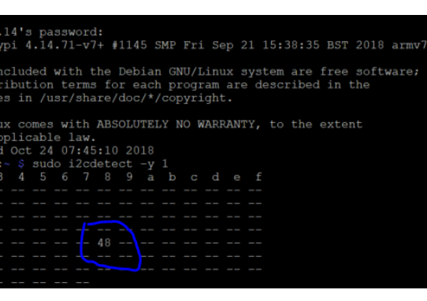
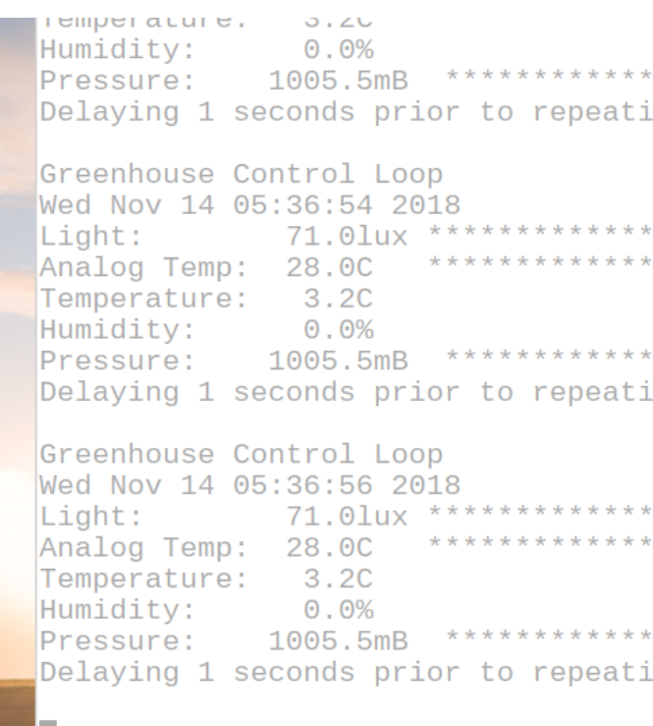
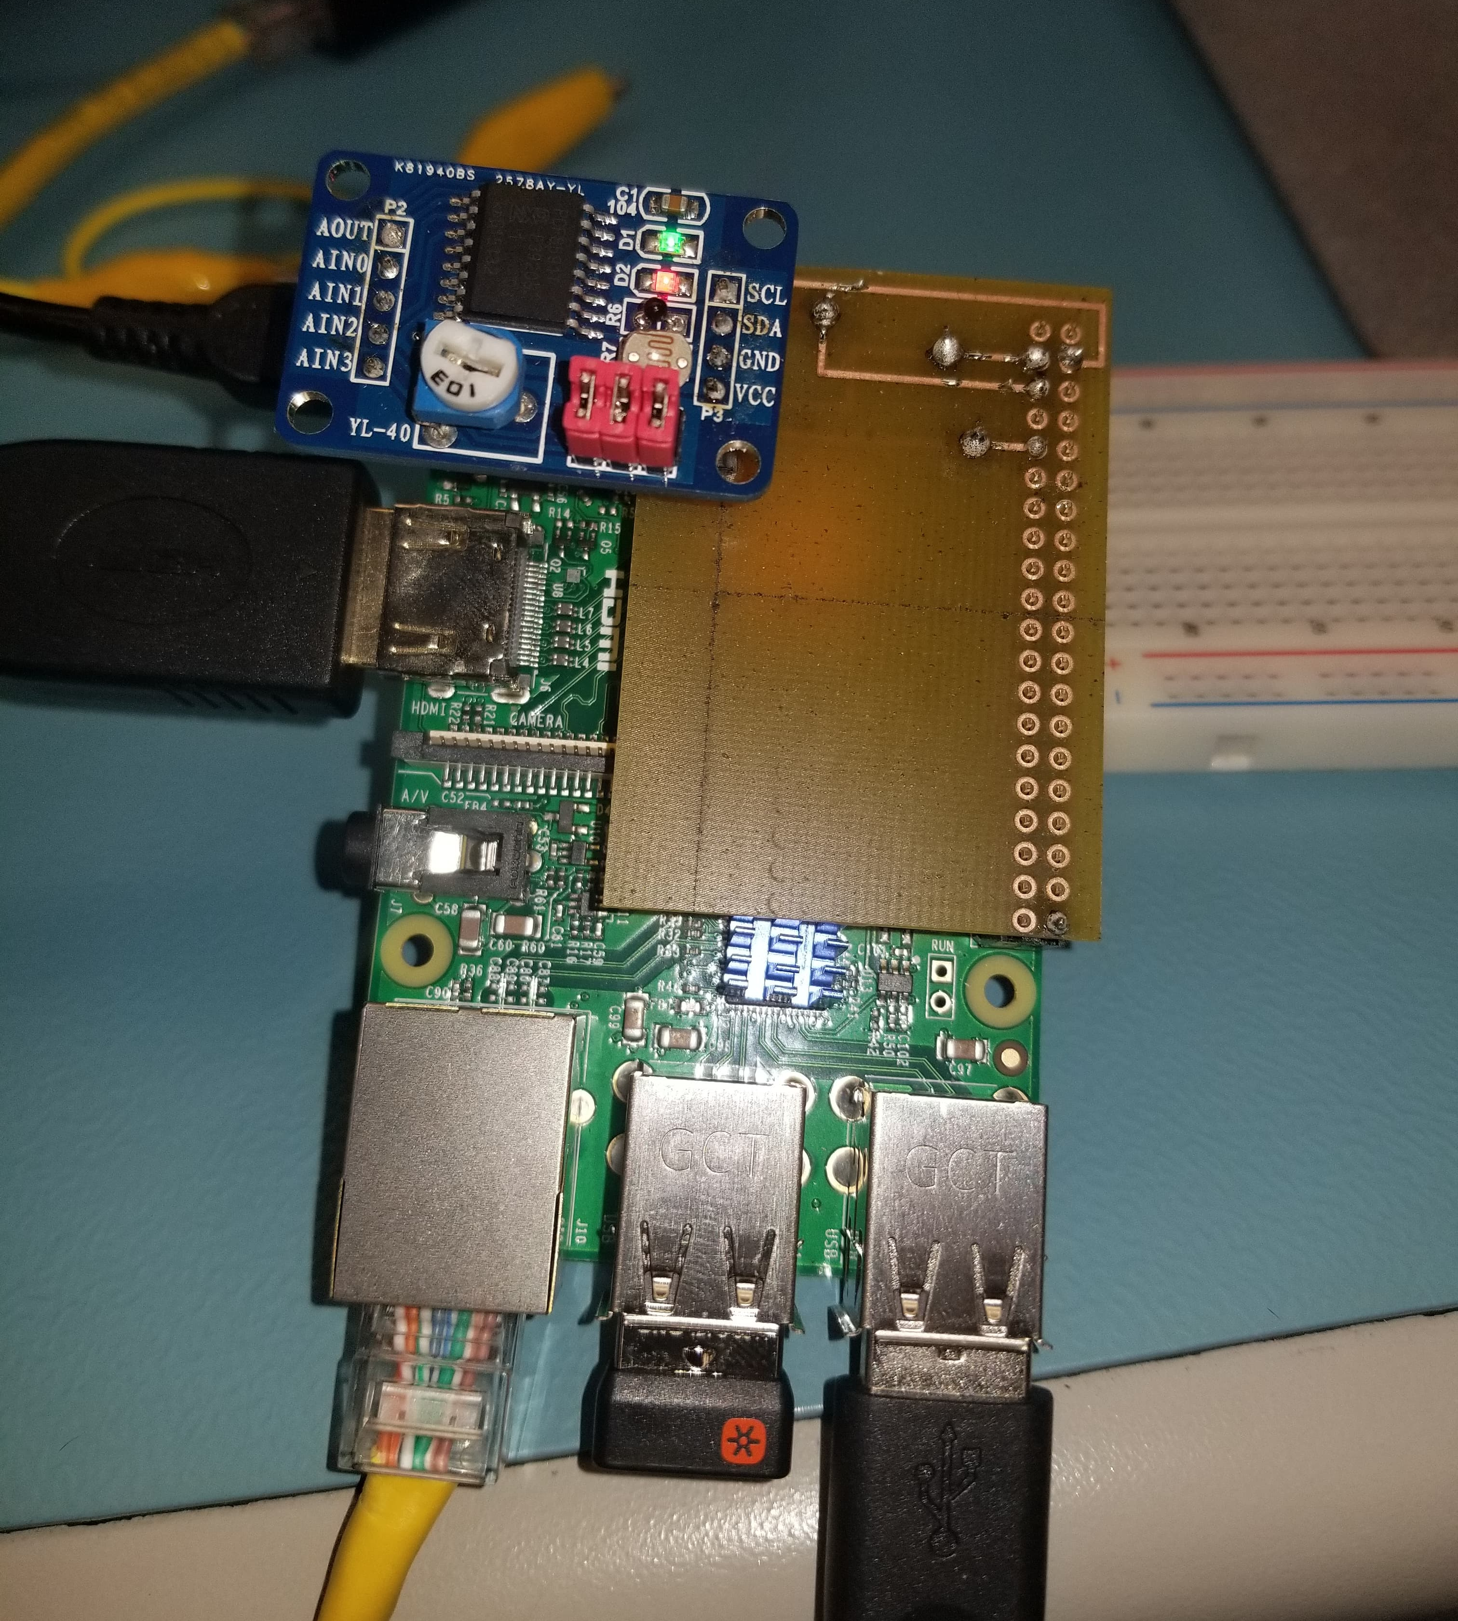
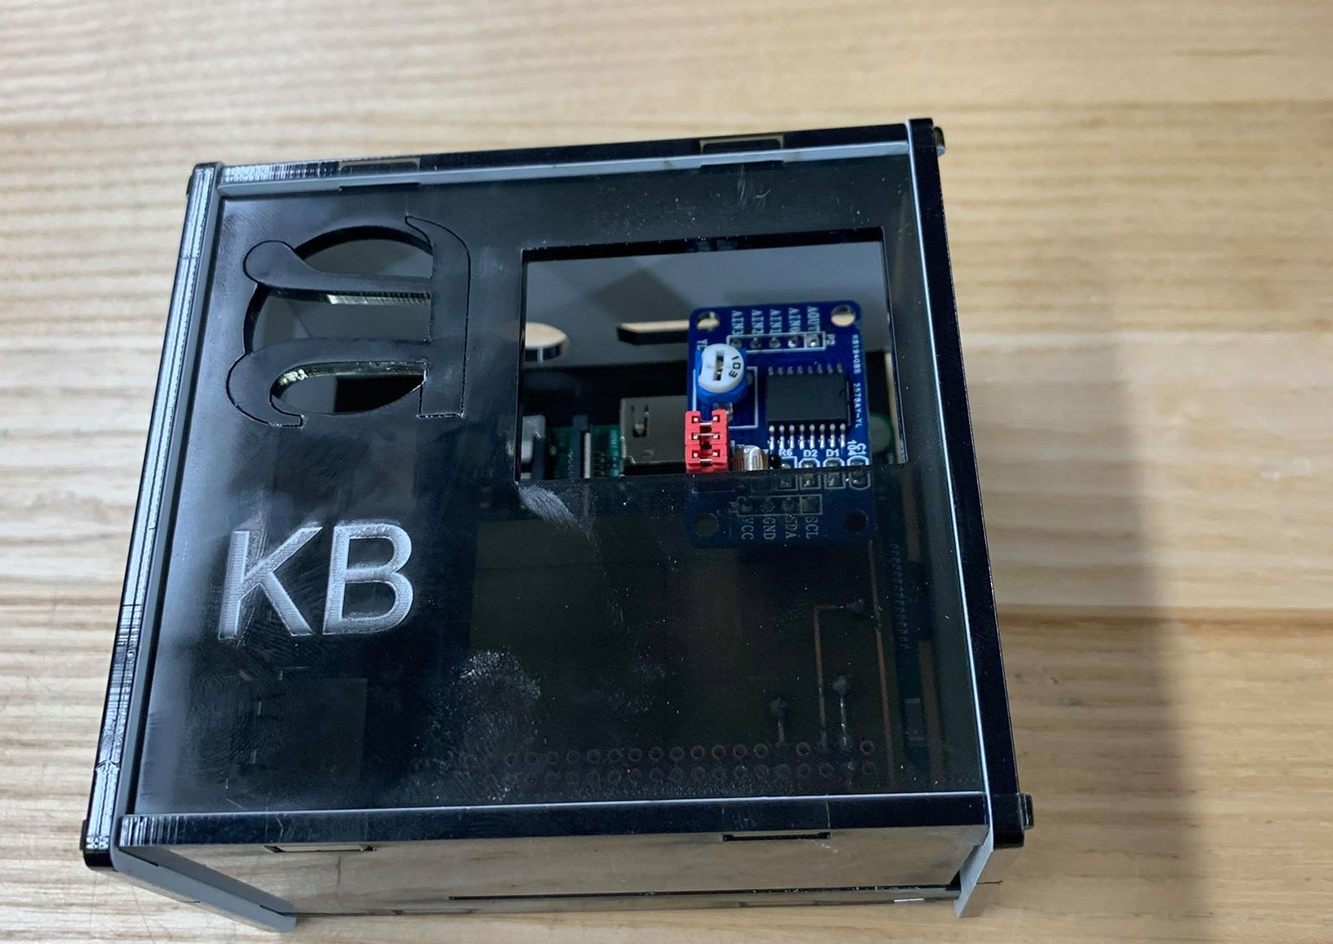

Screenshots of Working Code Detection and Enclosure

Slide 6
Course Knowledge from previous Courses Utilized in Project
Electrical Circuits – Basic Understanding of electrical components and theories
Programming Fundamentals – Introduction to C; Knowledge of basic programing; loops , if statements etc.
Technical C – Expanded knowledge of C programmed on Raspberry Pi using Remote Desktop Connection
Unix Internals – Basic info on how to traverse through the Unix shell; often used on Rpi 3
Embedded Systems - More In-depth Knowledge of microcontrollers and ICS

Slide 7
Thank You https://kogulb.github.io/KogulBCENG317Project/

